Slide 1
DATA- INTENSIVE COMPUTING

Slide 2
CONTENTS
What is data-intensive computing?
Characterizing data-intensive computations
Challenges ahead
Historical perspective
Technologies for data-intensive computing
Storage systems
Programming platforms.
Aneka MapReduce programming
Programming platforms.
Example application

Slide 3
Unit | Value | Size
bit (b) | 0 or 1 | 1/8 of a byte
byte (B) | 8 bits | 1 byte
kilobyte (KB) | 1000¹ bytes | 1,000 bytes
megabyte (MB) | 1000² bytes | 1,000,000 bytes
gigabyte (GB) | 1000³ bytes | 1,000,000,000 bytes
terabyte (TB) | 1000⁴ bytes | 1,000,000,000,000 bytes
petabyte (PB) | 1000⁵ bytes | 1,000,000,000,000,000 bytes
exabyte (EB) | 1000⁶ bytes | 1,000,000,000,000,000,000 bytes
zettabyte (ZB) | 1000⁷ bytes | 1,000,000,000,000,000,000,000 bytes
yottabyte (YB) | 1000⁸ bytes | 1,000,000,000,000,000,000,000,000 bytes

Slide 4
What is data-intensive computing?
Data-intensive computing is concerned with production, manipulation, and analysis of large-scale data in the range of hundreds of megabytes (MB) to petabytes (PB) and beyond.
Dataset is commonly used to identify a collection of information elements that is relevant to one or more applications
Datasets are often maintained in repositories,
To facilitate the classification and search, relevant bits of information, called metadata, are attached to datasets.
Data-intensive computations occur in many application domains

Slide 5
Application domains like:
Computational science
People conducting scientific simulations and experiments
Telescopes mapping the sky
Bioinformatics applications
Earthquake simulators
IT industry sectors –Petabytes per day/ per month/ not enough
telecom company
Google
Social networking and gaming
Facebook
Zynga
Farmville and Frontierville

Slide 6
Characterizing data-intensive computations
Data-intensive applications handle datasets on the scale of multiple terabytes and petabytes
Datasets are commonly persisted in several formats and distributed across different locations
Multistep analytical pipelines, including transformation and fusion stages
Efficient mechanisms for data management, filtering and fusion, and efficient querying and distribution

Slide 7
Challenges ahead
The huge amount of data produced, analysed, or stored imposes requirements on the supporting infrastructures and middleware that are hardly found in the traditional solutions for distributed computing
For example, the location of data is crucial as the need for moving terabytes of data becomes an obstacle for high-performing computations.
Data partitioning as well as content replication and scalable algorithms help in improving the performance of data-intensive applications.

Slide 8
Open Challenges
Scalable algorithms that can search and process massive datasets
New metadata management technologies that can scale to handle complex, heterogeneous, and distributed data sources.
Advances in high-performance computing platforms aimed at providing a better support for accessing in-memory multi terabyte data structures
High-performance, highly reliable, peta scale distributed file systems

Slide 9
Open Challenges
Data signature-generation techniques for data reduction and rapid processing
New approaches to software mobility for delivering algorithms that are able to move the computation to where the data are located
Specialized hybrid interconnection architectures that provide better support for filtering multi gigabyte data streams coming from high-speed networks and scientific instruments
Flexible and high-performance software integration techniques that facilitate the combination of software modules running on different platforms to quickly form analytical pipelines

Slide 10
Historical perspective
Support for data-intensive computations is provided by harnessing storage, networking , technologies, algorithms, and infrastructure software all together.
The early age: high-speed wide-area networking
Data grids
Data clouds and “Big Data”
Databases and data-intensive computing

Slide 11
The early age: high-speed wide-area networking
In 1989, the first experiments in high-speed networking as a support for remote visualization of scientific data led the way
1991 Supercomputing the remote visualization of large and complex scientific datasets (a high-resolution magnetic resonance image, or MRI, scan of the human brain) was set up between the Pittsburgh Supercomputing Centre (PSC) and Albuquerque, New Mexico, the location of the conference.
Kaiser project- high data rate and online instrument systems
Wide Area Large Data Object (WALDO) system –
Automatic generation of metadata;
Automatic cataloguing of data and metadata while processing the data in real time; facilitation of cooperative research by providing local and remote users access to data;
And mechanisms to incorporate data into databases and other documents.

Slide 12
MAGIC project- first data- intensive environment
DARPA-funded collaboration working on distributed applications in large-scale, high-speed networks.
TerraVision: Terrain visualization application that lets users explore and navigate a tri dimensional real landscape.
Clipper project- Main focus was to develop a coordinated collection of services that can be used by a variety of applications to build on-demand, large-scale, high-performance, wide-area problem-solving environments.

Slide 13
Data grids
Two main functionalities:
High-performance and
Reliable file transfer for moving large amounts of data, and scalable replica discovery and management mechanisms for easy access to distributed datasets.

Slide 14
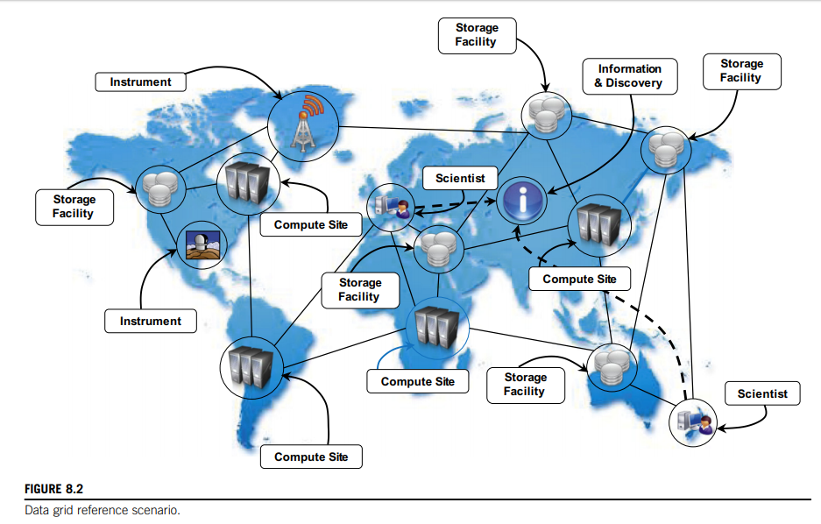

Slide 15
Besides heterogeneity and security, data grids have their own characteristics and introduce new challenges
Massive datasets- gigabytes, terabytes, and beyond. Minimal latency during bulk transfer of data.
Shared data collections- repositories can be used to both store and read data.
Unified namespace- unified logical namespace , mapped to different physical filenames for the purpose of replication and accessibility
Access restrictions- Authentication and authorization.

Slide 16
Research Fields: High-energy physics, biology, and astronomy
The LHC Grid: high-energy physics researchers around the world who are collaborating on the Large Hadron Collider (LHC) experiment.
BioInformatics Research Network (BIRN): to advance biomedical research through data sharing and online collaboration.
International Virtual Observatory Alliance (IVOA): virtual observatories, ever-expanding astronomical data resources available online (astronomical research programs can be conducted)

Slide 17
Data clouds and “Big Data”
Massive amounts of data are being produced, mined, and crunched by companies that provide internet services such as searching, online advertising, and social media.
Log analysis- companies such as google have a massive amount of data in the form of logs that are daily processed using their distributed infrastructure.
Together with the diffusion of cloud computing technologies that support data-intensive computations, the term big data has become popular.
Relational databases and desktop statistics/visualization packages become ineffective.

Slide 18
Big data problems are found in non scientific application domains such as : weblogs,
Radio frequency identification (RFID),
Sensor networks,
Social networks,
Internet text and documents,
Internet search indexing,
Call detail records, Military surveillance,
Medical records,
Photography archives, video archives, and large scale ecommerce.
New data are accumulated with time rather than replacing the old data

Slide 19
Cloud technologies support data-intensive computing in several ways:
By providing a large amount of compute instances on demand
By providing a storage system
By providing frameworks and programming APIs
A data cloud is a combination of these components.
Examples:
MapReduce- Google file Systems
Hadoop- Hadoop Distributed File System (HDFS)
Sphere- Sector Distributed File System (SDFS)
Greenplum-shared-nothing massively parallel processing (MPP)

Slide 20
Databases and Data-Intensive Computing
Natural evolution of database management systems.
Distributed databases are a collection of data stored at different sites of a computer network.
Each site might expose a degree of autonomy, providing services for the execution of local applications, but also participating in the execution of a global application
These systems are very robust and provide distributed transaction processing, distributed query optimization, and efficient management of resources.
Need to enforce ACID properties.
Limited abilities for scaling when compared to grid and Data clouds.

Slide 21
Technologies for data-intensive computing
Due to the explosion of unstructured data in the form of blogs, Web pages, software logs, and sensor readings, the relational model in its original formulation does not seem to be the preferred solution for supporting data analytics on a large scale.
Storage Platforms
Programming Platforms

Slide 22
Factors that effect traditional DB:
Growing of popularity of Big Data
Growing importance of data analytics in the business chain
Presence of data in several forms, not only structured
New approaches and technologies for computing.

Slide 23
High-performance distributed file systems and storage clouds
Distributed file systems constitute the primary support for data management.
They provide an interface whereby to store information in the form of files and later access them for read and write operations.
Among the several implementations of file systems, few of them specifically address the management of huge quantities of data on a large number of nodes.
Mostly these file systems constitute the data storage support for large computing clusters, supercomputers, massively parallel architectures, and lately, storage/computing clouds.

Slide 24
Popular Distributed File systems and storage clouds:
Lustre
IBM General Parallel File System (GPFS)
Google File System (GFS)
Sector
Amazon Simple Storage Service (S3)

Slide 25
General Reference Architecture
Two major roles
Metadata or master nodes contain the information about the location of files or file chunks
Whereas slave nodes are used to provide direct access to the storage space.
Client libraries, which provide a simple interface for accessing the file system
Variations of the reference architecture can include the ability to support multiple masters, to distribute the metadata over multiple nodes, or to easily interchange the role of nodes.
Common aspect among all the systems are : fault tolerant and high available storage systems.

Slide 26
NoSQL systems
The term not only SQL (nosql) was originally coined in 1998 .
Nosql cannot be considered a relational database.
The term nosql is a big umbrella encompassing all the storage and database management systems that differ in some way from the relational model
Overcome the restrictions imposed by the relational model and to provide more efficient systems.
Accommodate a larger range of data types or avoid joins to increase the performance and scale horizontally.

Slide 27
Two main factors have determined the growth of the NoSQL
Many cases simple data models are enough to represent the information used by application.
The quantity of information contained in unstructured formats has grown considerably in the last .
These two factors made software engineers look to alternatives that were more suitable to specific application domains they were working on.
Popular among them with their classifications are:-----

Slide 28
Document stores (Apache Jackrabbit, Apache CouchDB, SimpleDB, Terrastore).
Graphs (AllegroGraph, Neo4j, FlockDB, Cerebrum).
Key-value stores. This is a macro classification that is further categorized into key-value stores on disk, key-value caches in RAM, hierarchically key-value stores, eventually consistent keyvalue stores, and ordered key-value store.
Multivalue databases (OpenQM, Rocket U2, OpenInsight).
Object databases (ObjectStore, JADE, ZODB).
Tabular stores (Google BigTable, Hadoop HBase, Hypertable).
Tuple stores (Apache River).

Slide 29
Prominent Implementations that support data-intensive applications are:
Apache CouchDB and MongoDB.
Amazon Dynamo
Google Bigtable.
Apache Cassandra.
Hadoop HBase.

Slide 30
Programming platforms
Relational model proven unsuccessful for big data.
Distributed workflows have often been used to analyze and process large amounts of data .
This approach introduced a plethora of frameworks for workflow management systems.
Programming platforms for data-intensive computing provide higher-level abstractions, which focus on the processing of data and move into the runtime system the management of transfers, thus making the data always available where needed.

Slide 31
Most popular frameworks : The MapReduce programming model
Variations and extensions of MapReduce:
Hadoop
Pig
Hive
Map-Reduce-Merge
Twister
Alternatives to MapReduce
Sphere.
All-Pairs
DryadLINQ

Slide 32
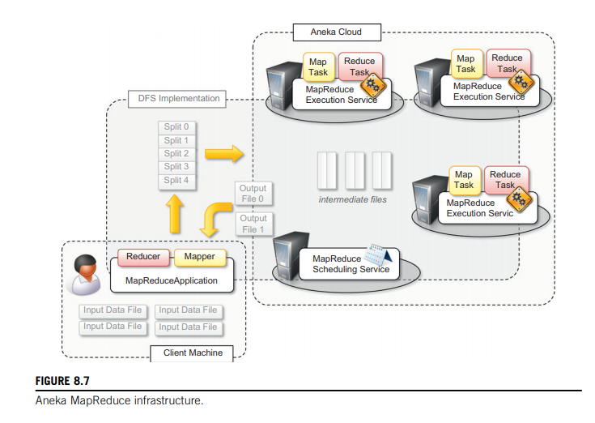
Aneka MapReduce programming

Slide 33
The runtime support is composed of three main elements:
MapReduce Scheduling Service, which plays the role of the master process in the Google and Hadoop implementation
MapReduce Execution Service, which plays the role of the worker process in the Google and Hadoop implementation
A specialized distributed file system that is used to move data files

Slide 34
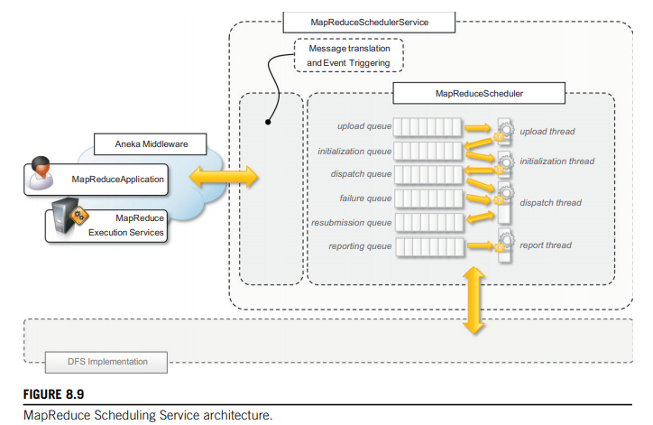

Slide 35
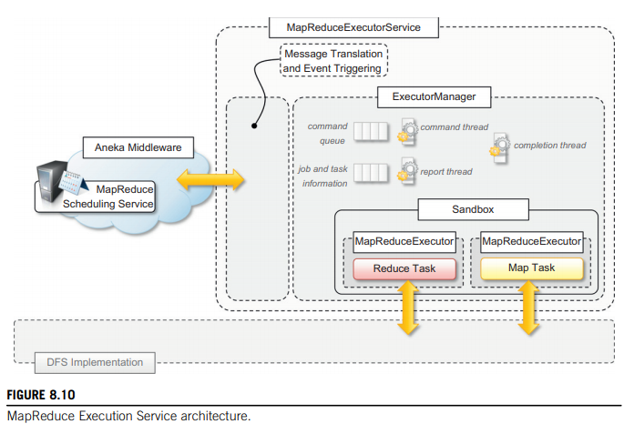

Slide 36
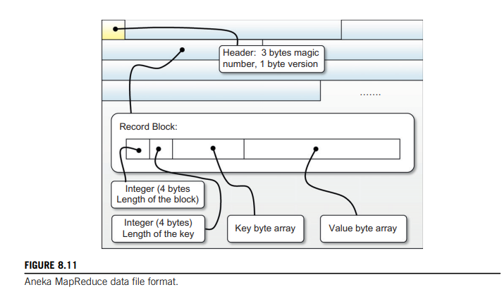

Slide 37
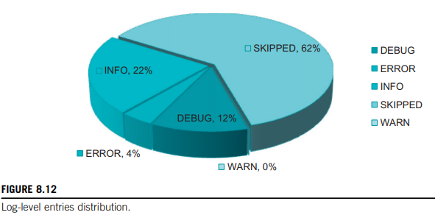
Example
To demonstrate how to program real applications with Aneka MapReduce, we consider a very common task: log parsing.
MapReduce application processes the logs produced by the Aneka container in order to extract some summary information about the behaviour of the Cloud.

